Slide 1
Making this resource work for you
Prior to teaching this lesson, please refer to the ‘Unit Overview and Planning Document’.
Further guidance on planning Science Mastery lessons can be found in the detailed planning guidance document.
Refer to the ‘notes’ section on each slide for useful information, including suggested expositions, pedagogical content knowledge, suggested questions, answers and more. Consider using presenter mode so you can see this guidance throughout the lesson.
The introduction slides can be adapted to suit your teaching style and the needs of your class.
Before the lesson, adapt the fix-it slide to address any misconceptions identified in the previous lesson’s exit ticket.
Choose from the suggested activities to suit your class. The intention is not that you complete all of these, but that you select those which ones are most appropriate for your students. It may be appropriate to further adapt activities for your students.
These lessons are designed to occupy approximately 1 hour. To adapt for a shorter or longer lesson duration we advise you to adapt the activity section accordingly.
Please consider using the final slide to send feedback about this lesson or examples of PowerPoints that you have adapted to our design team. Your feedback is used to improve Science Mastery for all of our teachers and students. We appreciate all suggestions and comments.
Thank you for reading!
The Science Mastery Team

Slide 2
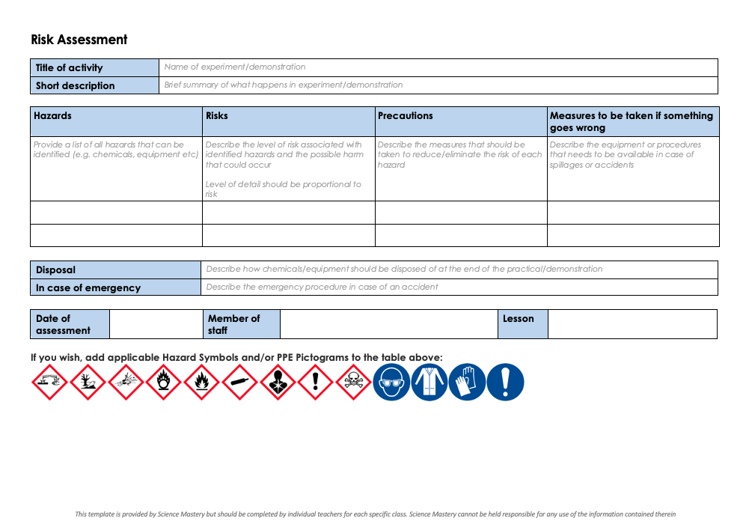
Practical Activity
This lesson contains a practical activity (either a whole class activity or a demonstration)
A risk assessment must be completed for this practical
The template risk assessment can be found here.
The risk assessment should be specific to the class involved and written only by the teaching member of staff
The risk assessment should refer to the current CLEAPSS Hazcards for all chemicals used in the practical for safety and disposal notes.
A list of chemicals used can be found in the Practical Guide
It is good practice for students to wear safety spectacles during all class practicals and demonstrations
Thank you for reading!
The Science Mastery Team

Slide 3
Observing Cells
Answer the questions below.
State the equation to calculate the magnification of an image.
Explain why electron microscopes are useful.
Name the part of the microscope where the magnification is adjusted.
Describe similarities and differences between plant and animal cells.
Name a type of plant cell that you would not expect to see many chloroplasts in.
$$Magnification= \frac{Size of image}{Size of real object}$$
They have greater magnification and resolution than light microscopes, allowing imaging of sub-cellular structures.
The objective lens
Plant and animal cells are both eukaryotic. They both contain a nucleus as well as a cell membrane, cytoplasm, mitochondria and ribosomes. Plant cells only also contain chloroplasts, vacuole and cell wall.
Root hair cell
Notes:
Foundation: Name the organelle that is the site of photosynthesis.
Stretch: Describe some specialised cells and explain how their structure makes them well suited to their function.
Answers:
Foundation: Chloroplast
Stretch: Any relevant specialised cell, e.g. sperm cell, red blood cell, neuron.
Model answers:
A sperm cell has a tail structure which makes it specialised to its function of having to swim towards the egg cell for fertilisation.
A red blood cell has a biconcave cell structure which increases its surface area; this is an adaptation to its function of carrying oxygen, so that more oxygen can diffuse into the cell.
A neuron has a very long axon in its structure, which allows the cell to send messages across a long distance, e.g. from the spinal cord to the end of the foot.

Slide 4
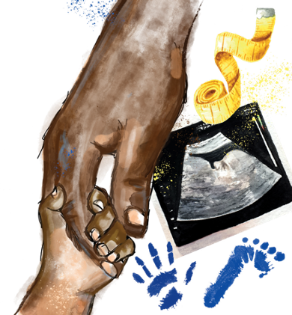
B3.1.6
21/10/2024
Observing Cells
B3.1.1 Prior Knowledge Review
B3.1.2 Eukaryotic and Prokaryotic Cells
B3.1.3 Aseptic Technique
B3.1.4 Growth of Bacteria
B3.1.5 Microscopes
B3.1.6 Observing Cells
B3.1.7 Diffusion
B3.1.8 Diffusion in Living Things
B3.1.9 Osmosis
B3.1.10 Osmosis Investigation
B3.1.11 Active Transport
B3.1.12 Cell Division
B3.1.13 Cancer
B3.1.14 Stem Cells
Notes:
Big Idea: Cells are alive
In this lesson pupils will develop their skills of using microscopes and the magnification equation. Following on from these lessons on viewing cells, pupils will move on to the rest of the unit which looks at different cellular processes, the knowledge of which has been influenced largely by the use of microscopes.
Hook:
A good question to ask pupils here thinking back to Y7 is ‘how would you observe a colourless object under the microscope’? You can link back to the process of making a microscope slide and adding a stain to ensure the specimen can be seen. Pupils should be familiar with this from either onion cells stained by iodine or cheek cells stained by methyl blue in Y7.

Slide 5

Following this lesson, students will be able to:
State that light microscopes are used to look at the overall structure and size of cells
Describe how to look at a specimen under a light microscope
Explain how to ensure that your slide does not contain any bubbles or artefacts
Key Words:
magnification
image
objective lens
coverslip
eyepiece
slide

Slide 6
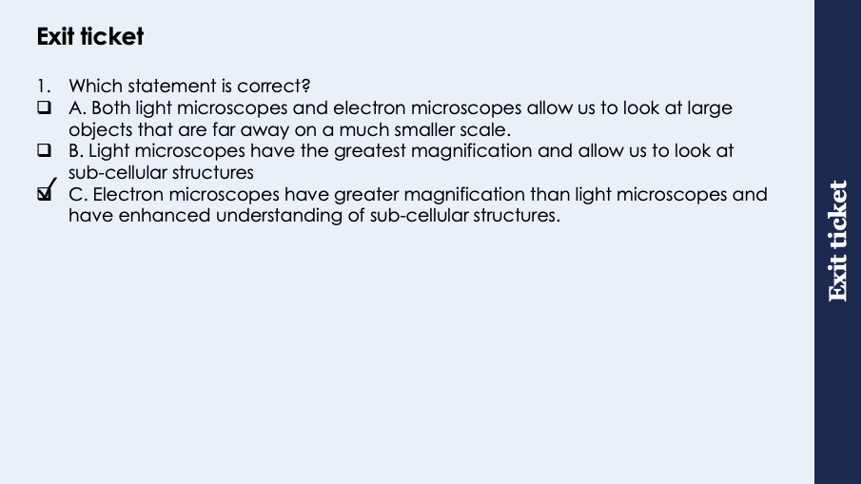
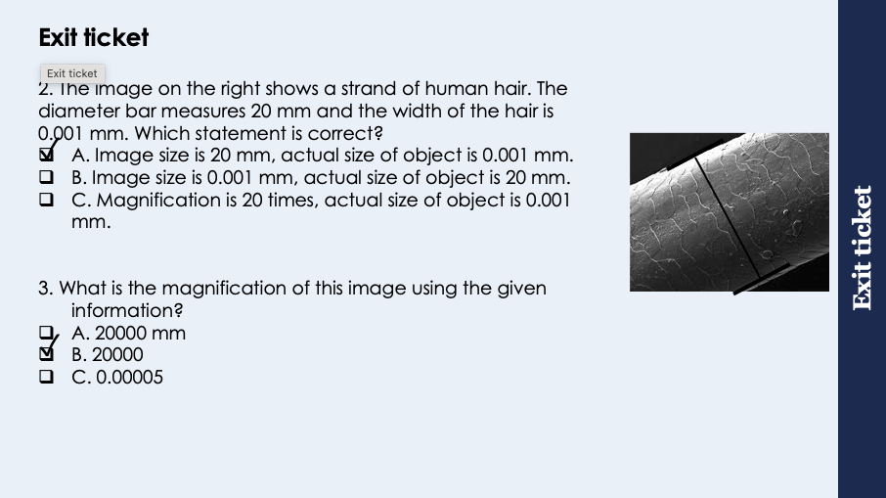
This is the fix-it portion of the lesson
The fix-it is an opportunity to respond to gaps in knowledge, especially those identified by the previous lesson’s exit ticket.
The teacher should customise this slide as needed, to facilitate
reteach, explanation, demonstration or modelling of ideas and concepts that students have not yet grasped or have misunderstood.
practise answering specific questions or of key skills.
redrafting or improving previous work.
Notes:
Purpose: to spend time on any gaps identified in previous learning from exit ticket feedback.
Answers:
Q1. Answer: C If pupils answer A they have the misconception of why microscopes are used- they are thinking of a telescope. If pupils answer B they may have been distracted by the information about sub-cellular structures. To fix it recap the differences between the types of microscope and when each would be used. Emphasise that both types of microscope allow scientists to view sub-cellular structures but electron microscopes have the higher magnification/resolution
Q2. Answer: A If pupils answer B they have interpreted the data from the question incorrectly. If pupils have answered
Q3. Answer: B If pupils have answered either A or C they have substituted incorrectly into the magnification equation. If pupils answered B to Q2 they will have got answer C to Q3. To fix it (Q2 and 3) practice a further magnification where pupils have to identify which is the actual size of the object and which is the size of the image and subsequently calculate the magnification.

Slide 7
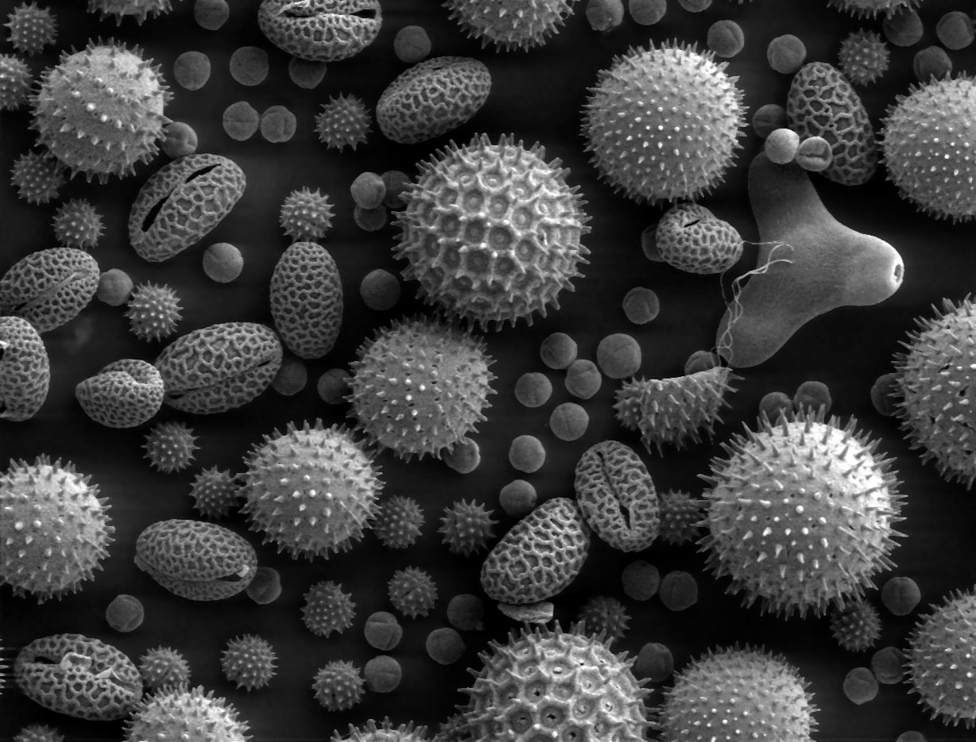
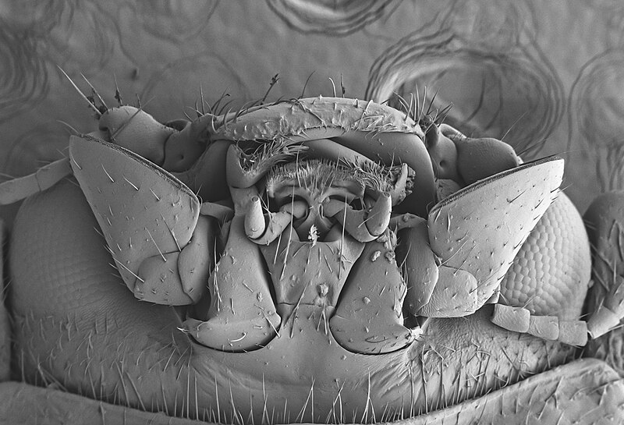
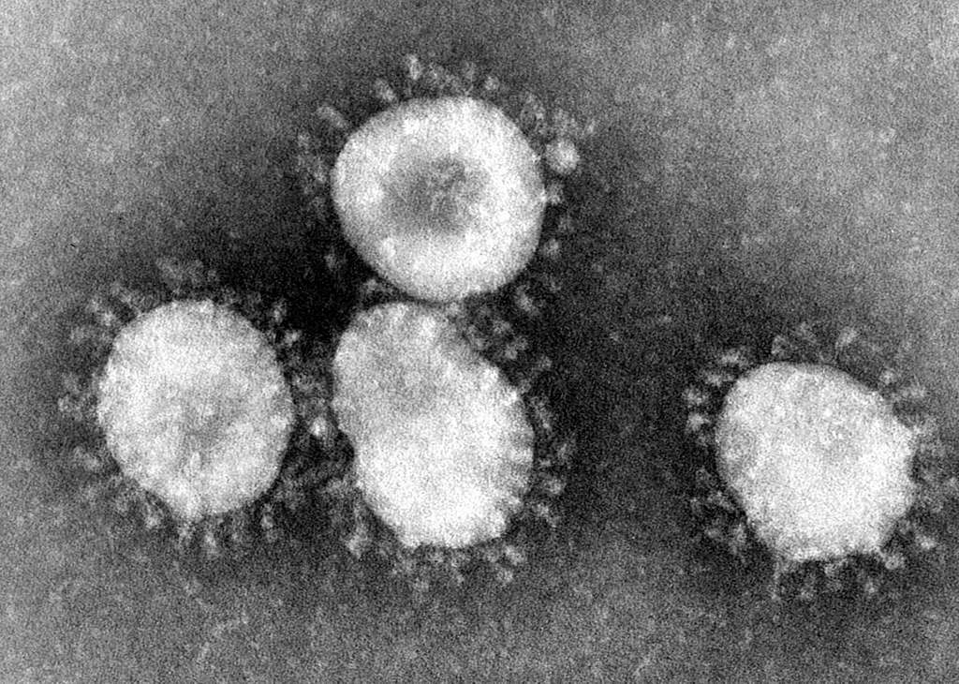
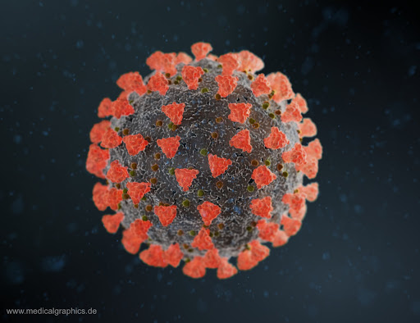
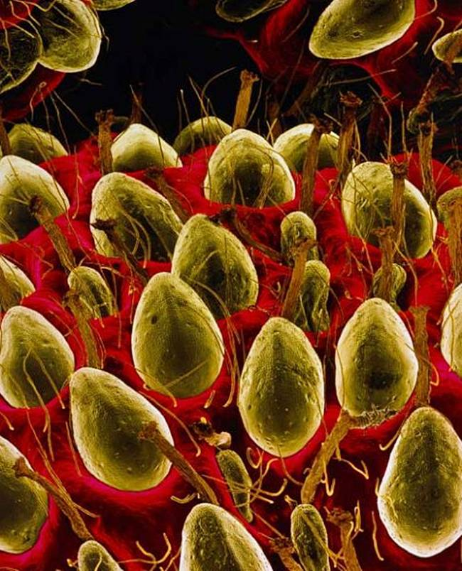
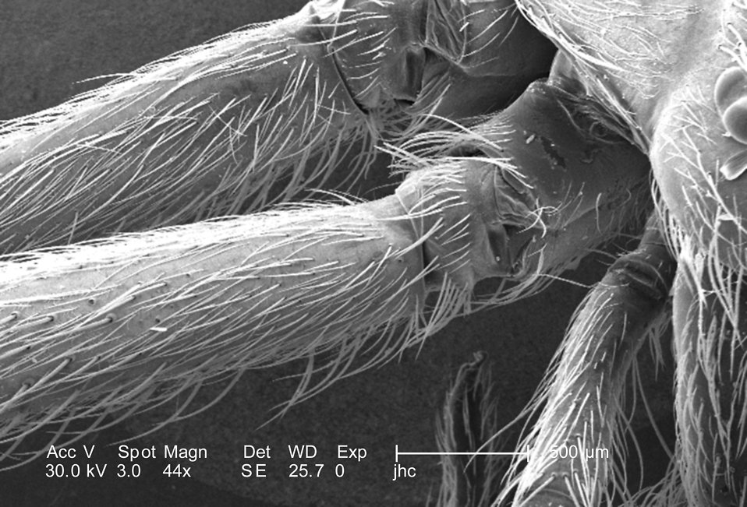
Can you guess what these electron microscope images show?
Notes:
Clockwise from top left
Pollen
head of a ladybird
Covid
Image sources:
CC@https://www.pickpik.com/pollen-microscope-electron-microscope-scan-plants-grayscale-39441
CC@https://commons.m.wikimedia.org/wiki/File:Cabeza_de_vaquita_de_San_Antonio_vista_bajo_el_microscopio_electr%C3%B3nico_de_barrido.jpg
CC@https://garystockbridge617.getarchive.net/amp/media/coronaviruses-004-lores-50bdcc

Slide 8
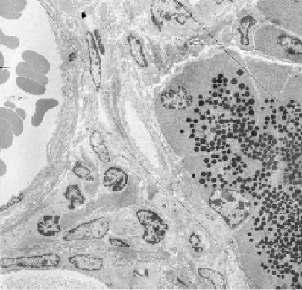
Observing Cells
Light microscopes are very useful to look at the overall structure and size of cells.
Electron microscopes are much more expensive but allow scientists to look at organelles within the cells, and even within the organelles.
Microscopic images must always show the magnification so they can be compared with images from other scientists.
Notes:
Type of exposition: Explanation
Suggested script:
Last lesson we mentioned light and electron microscopes. Electron microscopes allow scientists to observe specimens at a much higher magnification and resolution meaning they can see in more detail.
What is the difference between magnification and resolution? Magnification is making an object appear larger than it actually is​. Resolution is the ability to distinguish between two points (e.g. how detailed/blurry the image is)
You would never be able to see the detail in the image on the board with a light microscope. However, electron microscopes are not cheap- they can range in price from around £100,000 up to £1million plus they are meters high in size meaning you need a big enough space or room to install them. This means that the only places you tend to find electron microscopes are in university labs, in schools and colleges we stick to light microscopes.
When using microscopic images, or drawing images from under the microscope we always need to know the magnification as without this scientists would have no idea of the relative size of the object they are looking at. And would not be able to compare different images. Therefore the magnification should always be included with any photos or diagrams.
How do we calculate the total magnification for a light microscope that we are using? Total magnification = Eyepiece magnification x objective lens magnification
Image source:
Cropped from CC@https://commons.wikimedia.org/wiki/File:0311_Pancreatic_Cells_Micrograph.jpg

Slide 9
Quick Quiz
Choose the correct answer for each question:
Which is the correct equation to calculate magnification?
A. Magnification = size of image/size of real object
B. Magnification = size of real object/size of image
C. Magnification = size of image x size of real object
Which is the correct first step in focusing an image using a light microscope?
A. Ensure the objective lens is on the highest power of magnification
B. Ensure the objective lens is touching the slide
C. Ensure the objective lens is on the lowest power of magnification
✓
✓
Notes:
Purpose: assess understanding of new information. Get students to hold up hands with number of fingers to choose answer. Take consensus with answers and use questioning to explain why these are the answers.
Q2 is particularly important in terms of microscope skills – they should be very careful when selecting the correct magnification for the objective lens and the slide should never touch the lens.

Slide 10




Which statements do you agree with?
I think that we add stains like iodine to our slides so that we can see sub-cellular structures more clearly
I think that when you use a microscope you should start with the highest objective lens
I think that the fine focusing wheel is used to get the cells into the frame
I think that making sure the specimen is thin is really important
Notes:
Purpose: Designed to gauge prior understanding of how to use a microscope
Blue – false – need to start with lowest objective lens
Yellow – true- you can link the iodine staining back to the starch food tests from Y8
Green – true – need to ensure layers of cells don’t overlap
Red – false – course focusing wheel gets cells into frame, fine focussing wheel sharpens the image
Suggested guidance:
Talk tasks can be used in a variety of ways to suit the particular needs of the students you are teaching. Through exchanging views with others, students develop their understanding of the science beyond what could be achieved individually.
Science classrooms that successfully integrate talk have the following features:
Science talk is a regular feature of lessons and is woven into classroom activities.
Students are paired or grouped strategically by the teacher to ensure productive interaction. This might take into consideration the students’ proficiency of the English language, how encouraging they might be to peers and their attainment in the topic. It’s a good idea to consider these pairings in the class seating plan.
Students are encouraged and supported to talk, but are not forced to talk.
The teacher should take on the role of a facilitator, engaging with conversations where necessary and encouraging or steering the conversation where needed.
Students are encouraged to use the language they have to express their ideas (e.g., everyday language, imperfect English, native language), but also to incorporate science specific terminology where this is more accurate or has been taught.
6. Scientifically inaccurate ideas are not dismissed by the partner or teacher; open discussion and further investigation are relied on to help students construct ideas that support them to progress in their scientific understanding.
7. Guidelines for behaviour during talk tasks are explicit and frequently reviewed. Rules for students might be:
Listen carefully to your partner
Take turns talking.
Speak one at a time, without interrupting.
Politely agree or disagree and explain why.
Politely point out if your partner has used a scientific word incorrectly, if they have explained the science incorrectly, or if there is a more accurate way to describe something.
If confused, ask questions.
Stay focused on the discussion topic.
Respond to one another.

Slide 11
Drill
Name the piece of equipment used to place a thin layer of onion onto the microscope slide
Name the stain used to see the onion cells more clearly under the microscope
What is used to move the stage up when focussing the object under the microscope?
The actual length of a palisade cell is 0.06mm. Convert this to µm.
Explain why it is easier to view the cells using the low power objective lens first.
Explain why the objective lens should not be moved towards the stage when focussing the image.
A student views a slide under a microscope with an eyepiece lens of x5 and the ×10 objective lens. What is the total magnification of this image?
Notes:
Purpose: This is a knowledge drill. The purpose of this is to check that the critical knowledge is secure before pupils move onto independent practice.
Suggested guidance: There are a range of ways this could be done depending on time and ability range of the class:
Mini whiteboards
As full sentences in exercise books
As short answers in exercise books
In the pupil workbook
As pair talk
As cold call

Slide 12
Drill answers
Forceps
Iodine
The coarse focus wheel
70 µm
Biggest / widest field of view or easier to focus
To avoid damage to lens / slide
X50
Notes:
Purpose: This is a knowledge drill. The purpose of this is to check that the critical knowledge is secure before pupils move onto independent practice.
Suggested guidance: There are a range of ways this could be done depending on time and ability range of the class:
Mini whiteboards
As full sentences in exercise books
As short answers in exercise books
In the pupil workbook
As pair talk
As cold call

Slide 13
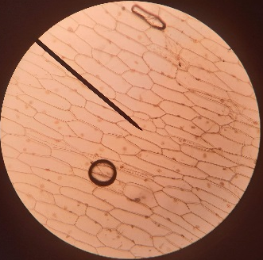

I: Describe the process in an accurate way
Example question:
To ‘describe’, your answer should:
Use bullet points.
Include each step of the process in a logical order.
Use keywords throughout the answer
Stay focused on the question.
A student observed slides of onion cells using a microscope. The image is not magnified, and the cells appear very small.
Describe how a student could adjust the microscope to see the onion cells more clearly.
Model answer:
Turn the objective lens
To a higher power lens
To increase magnification
Notes:
This slide models the process of answering a describe question.
Firstly, students are presented with a generic describe question, along with a model answer. Students are also given some simple guidance to follow for producing their own describe answer.
The generic question and answer should be used by the teacher to remind students of
the key features of a great answer
how to structure their answer
why the model answer is a good example
Following this, students will be required to apply this process to answer their own describe question, which will appear in place of the generic questions. This describe question will be specific to the topic students are learning about in the lesson. Give students time to write their own answer to this, ensuring that they use the guidance provided. To further scaffold this task for students, it may be appropriate to:
pair students up to write an answer together
list for students the key words you would like them to include in the answer
provide a writing frame or ‘points to include’ for students
A model answer for this question will appear. Teachers should review the model answer with students by referencing the guidance in the green box. For example ‘we can see item 1 in the guidance is to use bullet points to keep your answer clear. Notice in the model answer here we have done just that’. Or ‘item 2 in the guidance here says that we should use scientific keywords in the answer. Has this been achieved in the model answer? Where can we see this?’.

Slide 14
We: Describe the process in an accurate way
Example question:
To ‘describe’, your answer should:
Use bullet points.
Include each step of the process in a logical order.
Use keywords throughout the answer
Stay focused on the question.
Describe how to prepare a slide of onion cells to look at under the microscope
Model answer:
Peel a thin layer of tissue from the inner surface of the onion.
Use forceps to carefully lay this thin layer of tissue on the microscope slide.
Use the pipette to add a drop of iodine solution on top of the onion sample.
Carefully lay a coverslip on the slide, placing one edge down first and lowering the other side slowly.
Ensure any excess liquid is soaked up carefully using filter paper or paper towel.
Place the slide on the stage of the microscope and secure with the stage clips.

Slide 15
You: Describe the process in an accurate way
Example question:
Describe how to use a microscope to observe a prepared slide of onion cells at a magnification of x50 with an eyepiece lens of x5.
To ‘describe’, your answer should:
Use bullet points.
Include each step of the process in a logical order.
Use keywords throughout the answer
Stay focused on the question.
Model answer:
Place slide on stage
Ensure the objective lens is set to the lowest magnification
Use the x5 eyepiece lens
Look through the eyepiece and use the coarse focus wheel to bring the stage as close to the lens as possible
Slide must not touch lens
Turn the focus wheel the other way until the cells are more in focus
Rotate the objective lens to x 10
Turn the fine focus wheel to bring the cells into focus and look at the cells
×5 eyepiece and ×10 objective lenses (gives total magnification of ×50)
Notes:
Image: https://www.biologyforlife.com/uploads/2/2/3/9/22392738/compound-microscope-m500-left.jpg?376
This slide models the process of answering a describe question.
Firstly, students are presented with a generic describe question, along with a model answer. Students are also given some simple guidance to follow for producing their own describe answer.
The generic question and answer should be used by the teacher to remind students of
the key features of a great answer
how to structure their answer
why the model answer is a good example
Following this, students will be required to apply this process to answer their own describe question, which will appear in place of the generic questions. This describe question will be specific to the topic students are learning about in the lesson. Give students time to write their own answer to this, ensuring that they use the guidance provided. To further scaffold this task for students, it may be appropriate to:
pair students up to write an answer together
list for students the key words you would like them to include in the answer
provide a writing frame or ‘points to include’ for students
A model answer for this question will appear. Teachers should review the model answer with students by referencing the guidance in the green box. For example ‘we can see item 1 in the guidance is to use bullet points to keep your answer clear. Notice in the model answer here we have done just that’. Or ‘item 2 in the guidance here says that we should use scientific keywords in the answer. Has this been achieved in the model answer? Where can we see this?’.

Slide 16
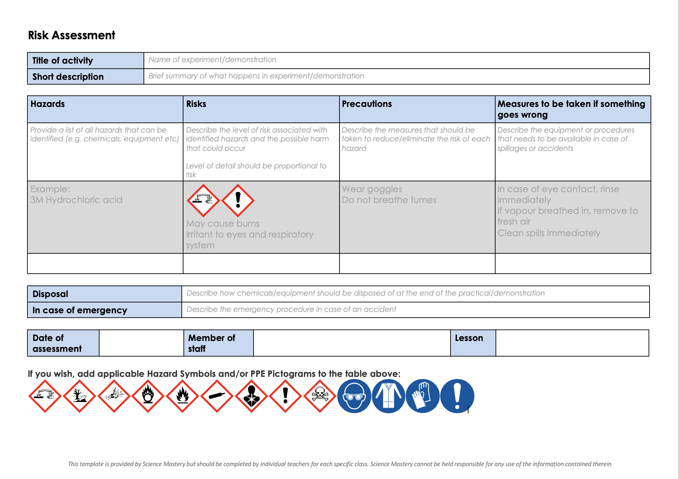
Risk Assessment
A risk assessment must be completed for this practical
The template risk assessment can be found here.

Slide 17
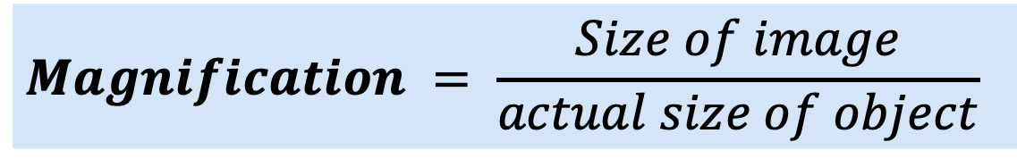
Complete the tasks below.
1. Carry out the investigation using the worksheet provided
2. Complete any sections that are missing
3. Draw and label your cells. Include the magnification that you have calculated.
$$Magnification = \frac{Size of image}{actual size of object}$$
Notes:
Purpose: carry out required practical. Separate technician/teacher guidance is provided with expected results and guidance on using graticules etc.
Suggested guidance: you may need to reteach key concepts or demonstrate how to use a microscope appropriately. You will also need to demonstrate how to use a coverslip here to avoid bubbles/fingerprints. Pupils will need to be given the interval value for each graticule at different objective lens powers, or stage micrometers can be used.
They have done this practical before in unit B1.1 so should be able to carry it out completely independently. Focus this time is on the rationale behind particular steps of the method so that pupils have a deeper of understanding of the method, as well as practising their use of the magnification calculation.
Onion recommended as it is the easiest to peel a layer of cells off and view the cells. Stretch activity can be to get students to get cheek cell samples using cotton buds and methyl blue staining.
The teacher should assess drawings to ensure they are scientific and drawn accurately.
Aim and questions can be self/peer assessed.

Slide 18
Answer the questions below.
Which statement is correct?
Light microscopes are able to show cell organelles in great detail
Light microscopes are useful for looking at relative sizes of cells
Light microscopes are useful for discovering new cell structures
2. Which is a precaution for looking at slides under a light microscope?
Ensure that there is no stain on the slide so it does not obstruct the sample
Ensure that the cover slip is carried and applied from the middle
Ensure that the sample of cells is a very thin layer
3. Which states the correct functions of the focusing wheels?
The fine focusing wheel is used to get the cells into the frame and the coarse focusing wheel is used to focus closely
The coarse focusing wheel is used to get the slide into the right position and the fine focusing wheel is used to get the cells into the frame
The coarse focusing wheel is used to get the cells into the frame and the fine focusing wheel is used to sharpen the image
✓
✓
✓
Notes:
Purpose: to find out if students are able to answer key questions that check for understanding of the new information that have been covered.
Answers:
Q1. Answer: B
If pupils answered A or C they may be confusing the light and electron microscope. To fix-it, go through the differences between light and electron microscope and when each one would be used.
Q2. Answer: C
If pupils answer A they may think a dark stain will not allow light to travel through. To fix it revisit the idea of stains being used to allow organelles to be seen. Pupils could practice writing a concise method for preparing and viewing a sample under a microscope, highlighting safety and accuracy precautions.
Q3. Answer: C
If pupils answer A or B they misunderstand the use of the focus wheels. To fix it pupils could practice writing a concise method for preparing and viewing a sample under a microscope, highlighting safety and accuracy precautions.

Slide 19
Lesson B3.1.6
What was good about this lesson? | What can we do to improve this lesson?
Send us your feedback by clicking this link
or by emailing sciencemastery@arkonline.org
Thank you!

